Slide 1
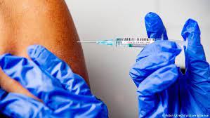
COVID-19
THE CHINA VIRUS AND VACCINES
FACT OR FICTION?
© 2021 by Peter M. Friedman

Slide 2
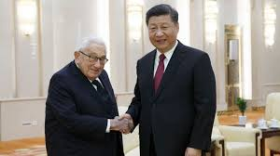
A Little History
For over 100 years theories have existed about world over-population. These ranged from Eugenics programs originating in the United States and England, to the Holocaust in Germany. In fact, in 1974 a classified study was created by the U.S. National Security Council under Henry Kissinger (“National Security Study Memorandum 200”). It studied the implications for world population growth and the potential impact on U.S. national security. The result was that population growth in the lesser-developed countries represented a serious threat to U.S. security. This study was officially adopted in 1975 by then President Ford.

Slide 3
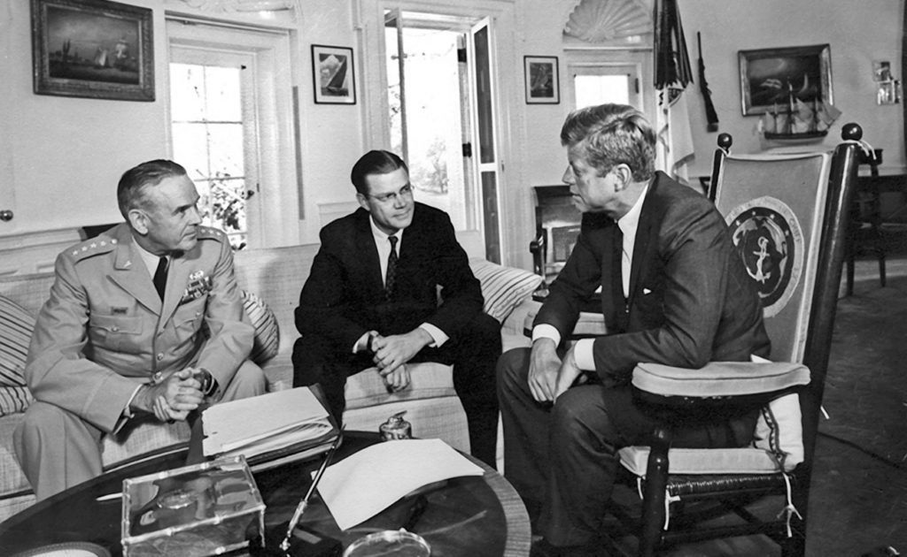
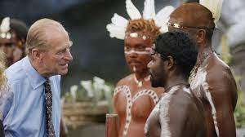
More History
In 1981 Chairman of the Joint Chiefs, Gen. Maxwell Taylor, advocated the reduction of population through wars, disease, and starvation! “I have already written off more than a billion people…from places in Africa, Asia, and Latin America. We can’t save them. The population crisis and the food-supply question dictate that we should not even try. It’s a waste of time.”
England’s Prince Philip, in People magazine, stated, “Human population growth is probably the single most serious long-term threat to survival. We’re in for a major disaster if it isn’t curbed.”

Slide 4
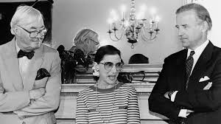
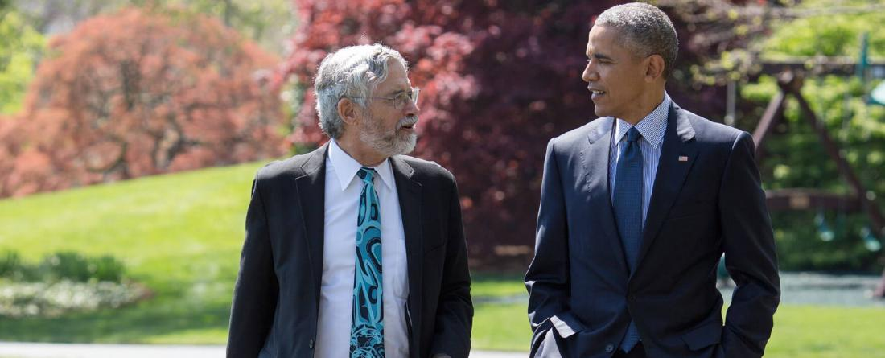
Still More History
In the 1970s Justice Ruth Bader Ginsberg, after the Roe v. Wade decision on abortion, stated the Supreme Court’s desire was to diminish “…populations that we don’t want to have too many of.”
Ginsberg expected that the right to abortion “…was then going to be set up for Medicaid funding for abortion.”
Ginsberg had researched the writings of John Holdren. Holdren became Barack Obama’s “Science Czar”, influencing Obama how science can affect public policy. Holdren was an arch Eugenicist believing in population “management” by totalitarian methods.

Slide 5
History May Be Repeating Itself
Under Obama, Holdren advocated mass vaccination for Swine Flu (H1N1) when it appeared in the U.S. in 2009. It originated in pigs in Mexico. 284,000 people died from Swine Flu. The CDC study in 2013 revealed that the vaccine developed only saved about 300 people, but allegedly prevented one million cases in America. (Big Pharma lost billions on vaccines never used!)
Swine Flu has been recognized since the 1919 pandemic and still circulates as a seasonal flu. In the 1919 pandemic over 700,000 people died worldwide supposedly because no vaccine existed.

Slide 6
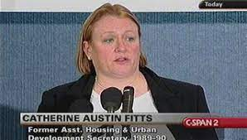
Official Policy
Catherine Fitts was Bush Sr.’s Assistant Secretary of Housing in 1991. Admitting that global depopulation was a “Globalist” goal, she stated, “Perhaps it is the goal of the swine flu epidemic as well, whether bio-warfare or hype around a flu season.”
Fitts further stated, “We had to have a radical change in how we governed resources or depopulate. It was a mathematical result.”
Fitts further stated, “Unless you change the actuarial assumptions in the budget – like life expectancy, lowering immune systems and increasing toxicity levels combined with poor food, water, and terrorizing stress will help do the trick.”

Slide 7
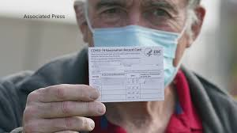
The Effect of Pandemics
A pandemic can so frighten and control a population that they will accept the end of their “normal” existence without serious objection.
Vaccines rushed into production without proper testing and peer review is a way to keep control in a situation that is quickly spiraling out of control.

Slide 8
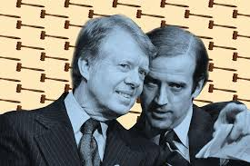
Man-made Killer Pandemics
There are growing concerns that some pandemics are man-made to achieve population control, and in some cases active depopulation.
In 1969, Dr. D.M. MacArthur revealed that DoD was working on a virus that would seriously compromise the human immune system!
In 1980, under Jimmy Carter, the State Department issued a report, “Global 2000”, advising that the world population must be reduced by two billion people by the year 2000.
Finally, in 1983, AIDS was publically recognized as a deadly and spreading disease. It was originally diagnosed in the U.S. in 1978.

Slide 9

Depopulation and the Environment
In 1996 a full-page ad appeared in Foreign Affairs, the official publication of the Council on Foreign Relations. “We need a smaller population in order to halt the destruction of our environment, and to create an economy that will be sustainable over the very long term. The root cause – overpopulation.”
The ad advocated a maximum U.S. population of 150 million. We today are over twice that!
In 2009 the U.S. population was estimated at 307 million. It has increased by nearly 10% since then.

Slide 10
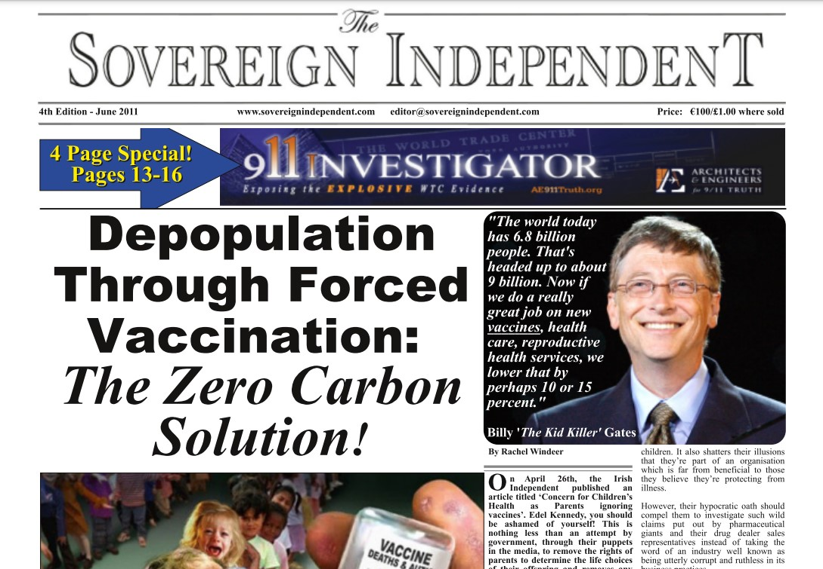
Globalist Thinking
On February 8, 2009, Obama’s national security adviser Gen. James Jones, stated while in Germany that he takes his …”daily orders from Dr. Kissinger, filtered down through Gen. Brent Scowcroft and Sandy Berger.”
On May 5, 2009 there was a meeting in Manhattan attended by Bill Gates, David Rockefeller Jr., Warren Buffet, George Soros, Michael Bloomberg, Ted Turner, and Oprah Winfrey, all wealthy Globalists.
They all agreed that human overpopulation was a serious priority. This was reported by John Harrow in the Sunday Times.

Slide 11
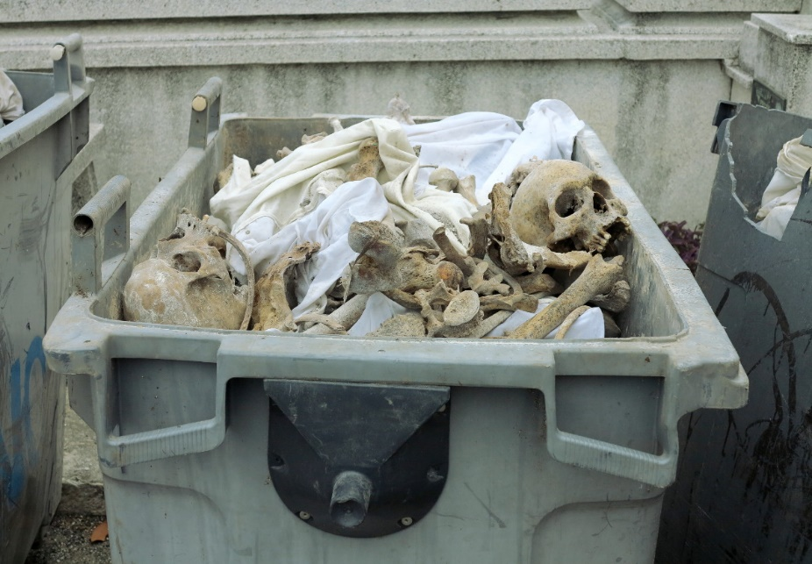
Dead Microbiologists
By summer 2009, over 100 microbiologists around the world had died, many under very suspicious circumstances. The majority were involved in virus research.
Were these microbiologists seeing through schemes of fraudulent manmade pandemics and working on antidotes?
The names of these microbiologists can be found at Http://www.puppstheories.com/forum/index.php?showtopic=6521.

Slide 12

Big Pharma – Drugging the Population
Drugs are big business! 40% of the commercials on TV are for drugs.
Only half the drug manufacturers are in America such as Pfizer, Merck, J&J, Bristol Meyers-Squibb, and Wyeth. The rest of the top companies are in Europe : Astra-Zeneca, Glaxo-Smith-Kline, Novartis, Roche, and Aventis.
In 2007 the drug market was $712 billion globally. $80 billion was for psychiatric drugs like Prozac, Ritalin, Zoloft, etc.
Most “new” drugs are only variables of old drugs due to patent rights.
New diseases are “invented” to be cured by existing drugs!

Slide 13
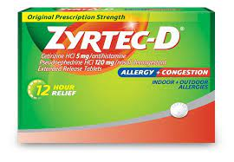
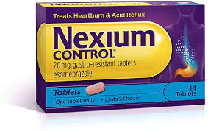
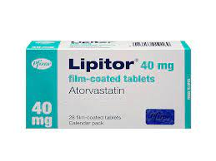
DTC ADS – BIG MONEY!
Lipitor earns $34.09 for each ad dollar spent on TV!
Nexium earns 44.92 for each ad dollar spent on TV!
Singulair earns $45.24 for each ad dollar spent on TV!
Zyrtec earns $33.86 for each ad dollar spent on TV!
Since the FDA allowed TV drug ads in 1997, DTC ads went from $1.3 billion yearly to over $5 billion today!
How much of these profits wind up in the pockets of legislators?
Many of these DTC drugs have been removed from the market due to safety issues.

Slide 14
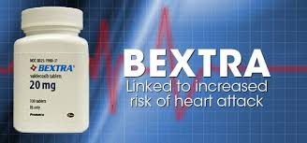
BAD DRUGS!
In 2009 Pfizer, the world’s largest drug maker, was fined $2.3 billion based upon unlawful prescription drug promotions. One of the four drugs, Bextra, increased the chances of heart attack, and was being used for treatments not approved.
Pfizer was named a “repeat offender” by the DOJ and required monitoring Pfizer for five years.
Pfizer has taken doctors on vacations to golf resorts, and other perks such as expensive restaurants in order to persuade them to prescribe Pfizer drugs, especially in taxpayer-funded programs.

Slide 15

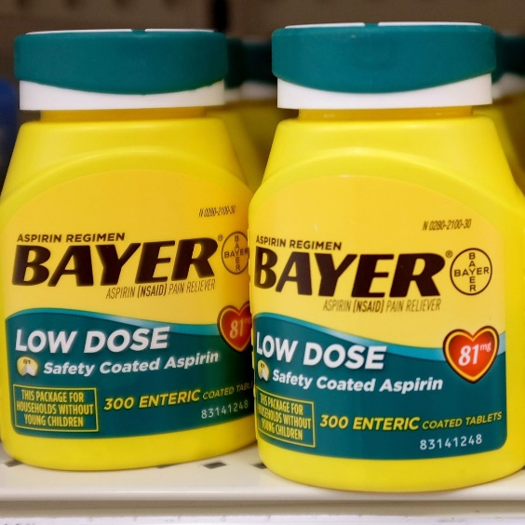
Nazi Connection?
The German drug company, I.G. Farben, was the manufacturer of the Zyklon B gas used during WW2 in the Nazi concentration camps.
In 1996 I.G. Farben merged with Ciba-Geigy of Switzerland creating Novartis, one of the largest corporate mergers in history!
The German drug company Bayer was once a part of I.G.Farben. Today Bayer is the largest manufacturer of Aspirin, especially the widely-used 81mg dose.

Slide 16
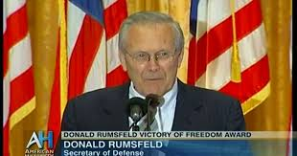

Closer to Home
Gilead Sciences, a local California drug company, created Tamiflu and Remdesivir.
A major stockholder in Gilead Sciences is Donald Rumsfeld, former Defense Secretary.
In 2005, when there was the threat of Bird Flu, Rumsfeld’s stock value in Gilead increased from $5 million to $25 million as reported by CNN!
This is why Americans travel to Mexico and Canada to buy prescription drugs! The cost is less than half there.

Slide 17
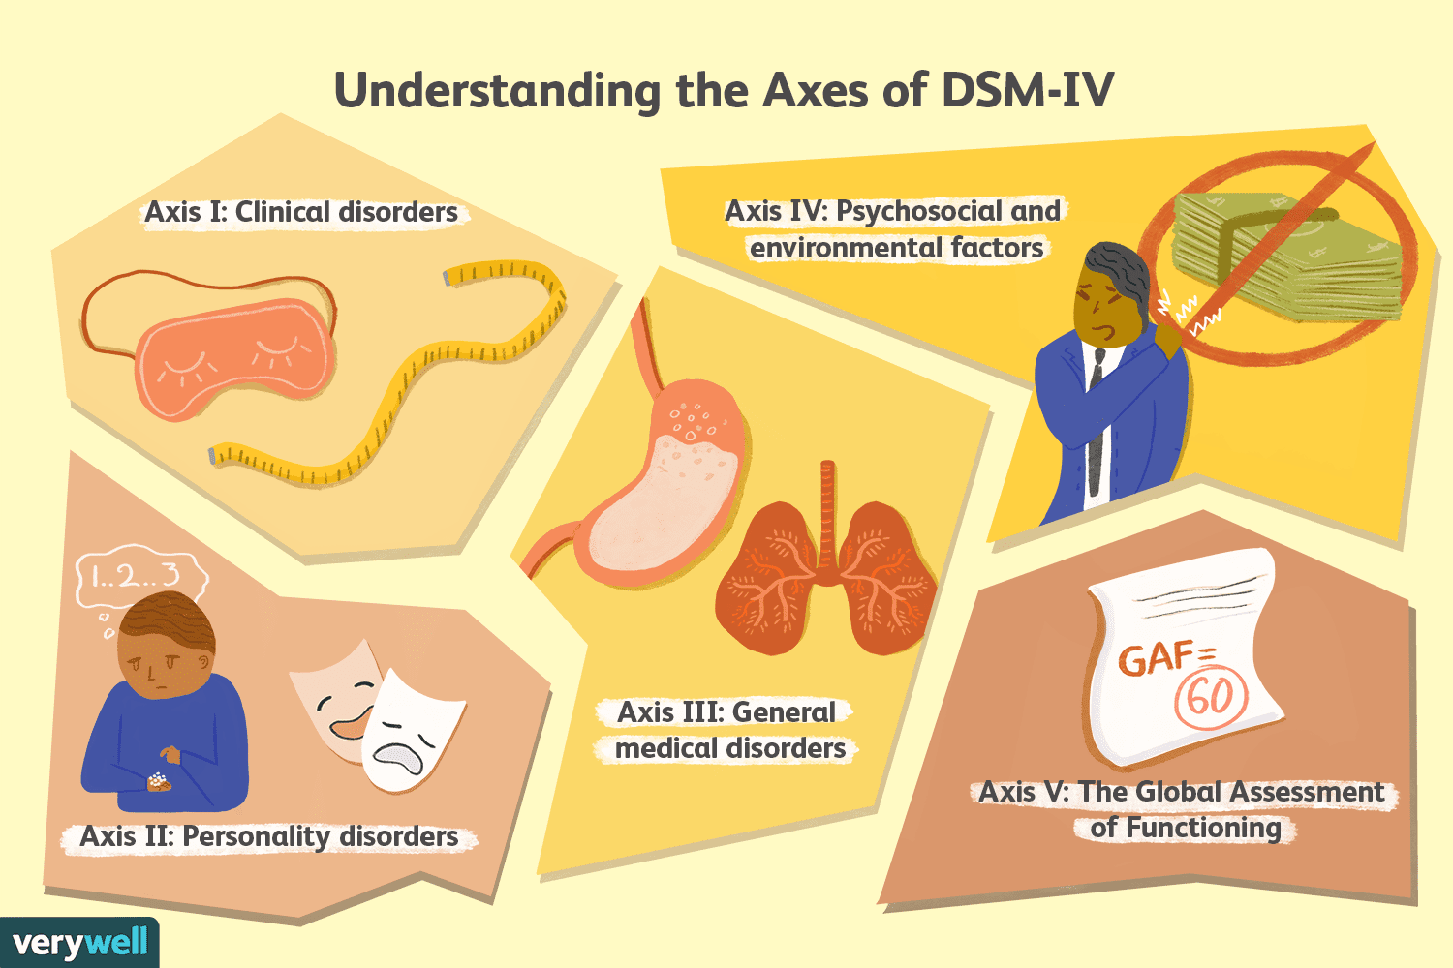
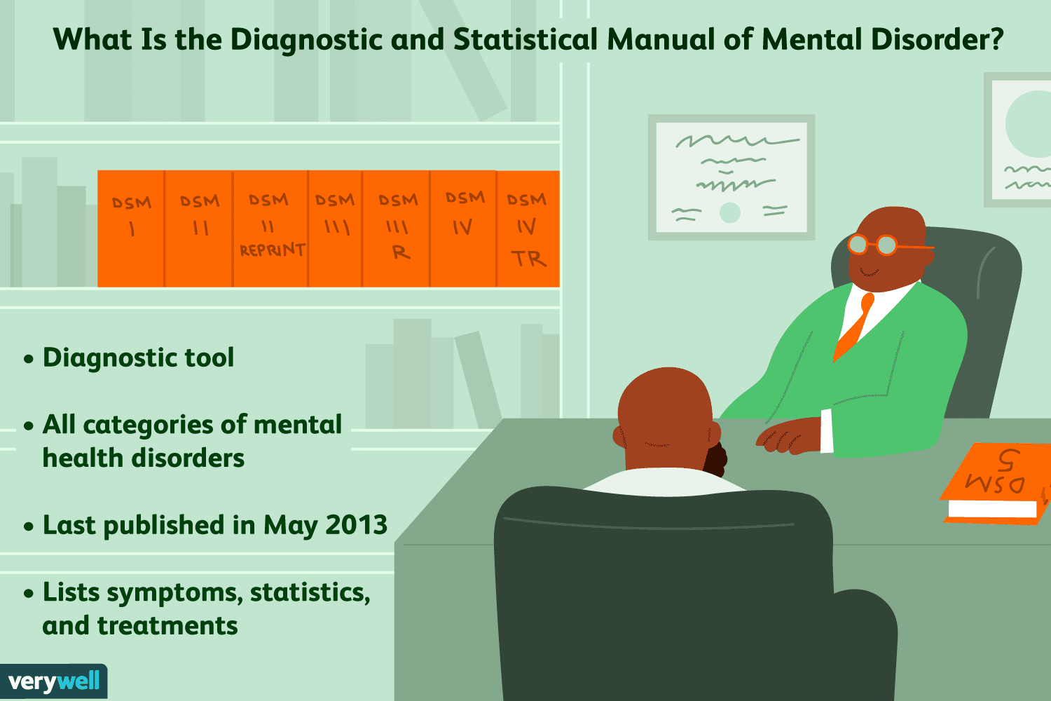
CONSERVATISM AND DRUGS
In 2003 the National Institute of Mental Health concluded that people who believe in traditional values such as marriage between men and women, balanced budgets, strict interpretation of the Constitution are mentally disturbed. They had spent $1.2 million of taxpayer money studying “The psychology of conservatism”.
They concluded that “the core of political conservatism was a resistance to change and a tolerance for inequality that promotes fear and uncertainty.”
Constitutionalists are now in danger of being diagnosed with a mental disorder!

Slide 18
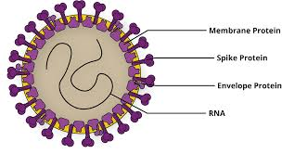
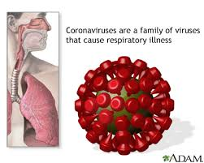
CORONA VIRUSES!
In December, 2019 large numbers of respiratory illnesses appeared in Wuhan, China, a “Coronavirus”, in a city of 10 million.
Corona viruses have existed with humans and animals for years worldwide with 20% responsible for respiratory issues.
In nursing homes, they account for about 8% fatality due to co-morbidities, why patients are there to begin with!
Only two coronaviruses made world headlines: SARS-CoV in 2003, which only killed 774 worldwide and cost $40 billion; MERS-CoV in 2012 originating in the Middle East with a fatality rate over 30% but quickly suppressed.

Slide 19

COVID-19 (SARS-CoV-2)
The initial fear was that it would not be a normal corona virus, but one that might be SARS-like and highly infectious and dangerous.
Wuhan, with five other cities, was encircled by the Communist Chinese Army and completely isolated supposedly.
China reported containment within a few months reporting “83,000” infected with only “5000” deaths. It was minimal in a country with a population of 1.4 billion. This is a fatality rate of 0.000005.
COVID-19 severe illness only occurs in less than 10% of cases.
A serious mistake occurred when anyone testing positive and then dying was classified as having died from COVID-19!

Slide 20

THE COVID-19 LIE CONTINUED
A French study reported on March 19, 2020 revealed that, of the 8000 patients with respiratory disease, only 50% or less had COVID-19. They concluded the danger had been overestimated.
The U.S. has reported over 500,400 deaths attributed to COVID-19, but, if you divide this number by the U.S. population of 320 million, the result is 0.000015. The government inflates this number by dividing the 500,400 deaths by positive testing cases resulting in 0.0007!
Lastly, our government reports 79,611,982 total tests with 6,873,739 positive. Then they report a 9% positive test rate! That’s SCARY!

Slide 21
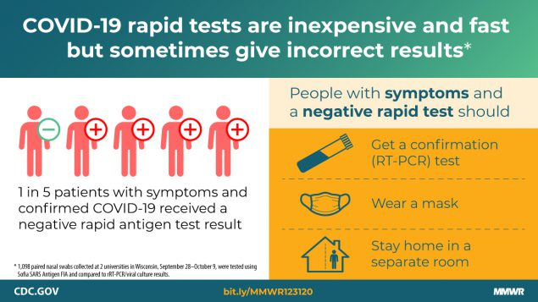

MORE COVID-19 LIES!
In order to answer how many Americans were/are actually infected you need to answer three questions: (1) How reliable is the test? (2) Who was tested? (3) How many deaths did COVID-19 really cause?
If you continue to test, but not report the appropriate and truthful death rate, you cause a “laboratory-created pandemic”.
The main test for COVID-19 is the Polymerase Chain Reaction (“PCR”) test. This test was created in Germany. Due to urgency, quality controls for PCR testing were ignored for COVID-19! Nobody really knows the efficacy of the PCR test because results will vary depending upon when you test someone after they become infected!

Slide 22
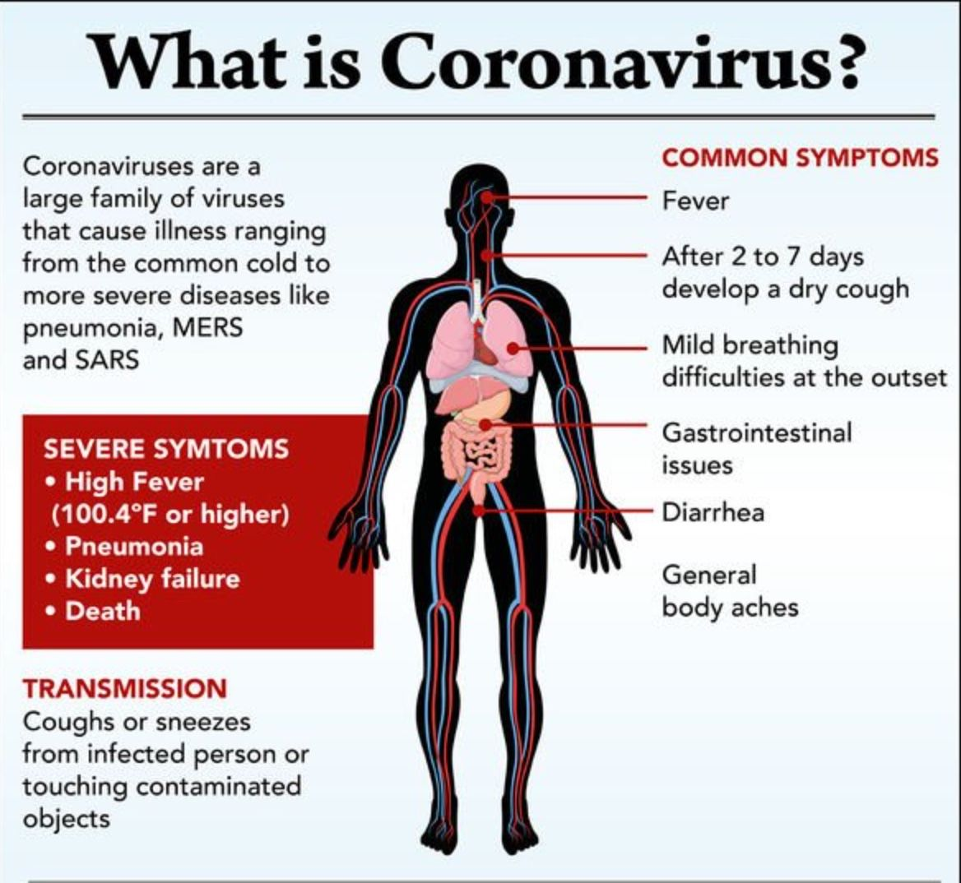
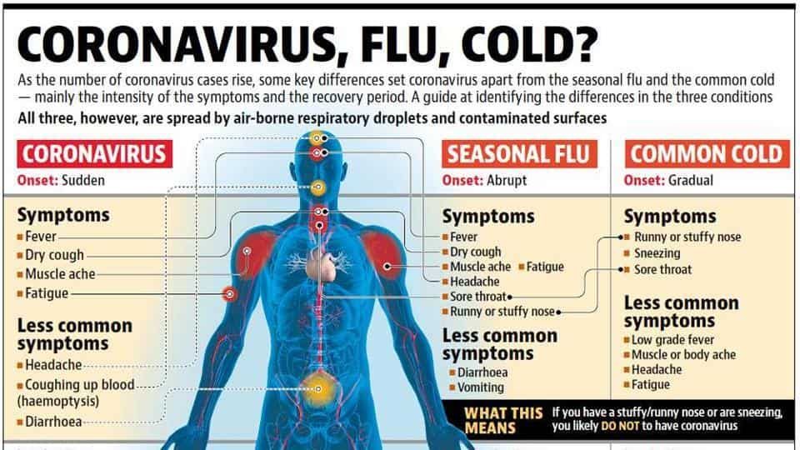
WHAT IS COVID?

Slide 23

WHO SHOULD BE TESTED?
To obtain accurate data you need to discriminate within a population to be tested. If you have an asymptomatic population, minimal tests are necessary. If you have a very vulnerable population, then a majority should be tested so anyone testing positive can be removed.
The only study of vulnerable populations occurred in Germany, but the media refused to report the study! The reported fatality rate found was ten times lower than the World Health Organization (“WHO”) was reporting! Remember, WHO is a UN subsidiary!
The majority of COVID-19 deaths were/are falsified or misreported.

Slide 24
WHO IS AT RISK?
In Germany for a person under 65 was the same as taking a 20-mile drive. Elderly persons over 80 had only 10 reported deaths per 10,000 resulting in a death rate of 0.001.
Elderly persons with co-morbidities already such as heart disease, lung disease, kidney failure, pneumonia, etc. are seriously vulnerable to any respiratory virus including the seasonal flu. (It has been reported by vaccine makers NOT to take the COVID-19 vaccine together with a seasonal flu vaccine!)
Case fatality rates for seasonal flu are 0.1% to 0.2%. WHO estimates about 500,000 flu deaths in a world population of 7 billion, or 0.000071. Little difference between COVID-19 and the seasonal flu!

Slide 25
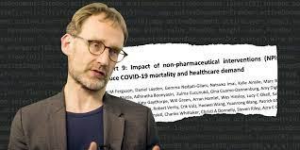
THE PANDEMIC STARTS!
On March 11, 2020 WHO declared a pandemic causing both Germany and France to close all public gatherings, including schools.
On March 16, 2020 clubs, museums, trade fairs, movie theaters, zoos everything was closed to prevent the healthcare system from being overloaded.
Numerous accredited medical personnel began to call these measures “A fiasco in the making!” The WHO continued to estimate a “3.4%” official death rate, which was completely false!
Now discredited Professor Neil Ferguson in the UK estimated a death rate of over “2 million” in America alone. He had been wrong before!

Slide 26
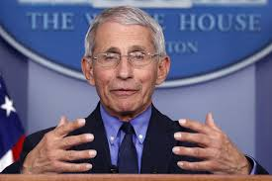
PANDEMIC FEARS!
Politicians began spreading fear for political gain! Let’s use COVID-19 to scare the population so we can control the message, especially in an election year! If voters are afraid to go physically to the polls to vote, we can manipulate the election with mail-in ballots.
“Power corrupts, and absolute power corrupts absolutely!” (Lord Acton)
Based upon the erroneous statements from Dr. Fauci and requests by Governor Cuomo in New York, President Trump sent a Navy hospital ship and erected a complete hospital inside the Javit’s Center in NYC, none of which was ever used!
Dr. Fauci made numerous contradictory statements about masks!

Slide 27
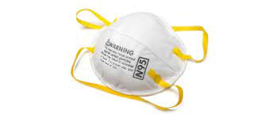
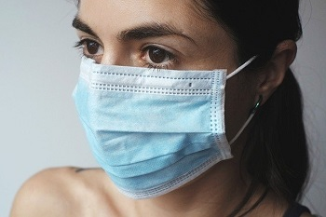
MASK TRUTHS!
Masks were now made mandatory by the government.
There is no scientific evidence that symptom-free people spread the virus.
Simple masks do not and cannot stop the virus.
Non-medical masks have very low filter efficiency, like a mosquito able to fly through a chain-link fence.
Cotton surgical masks have 97% penetration due to moisture retention, reuse, and poor filtration.
The best mask is a N95 mask worn correctly!

Slide 28
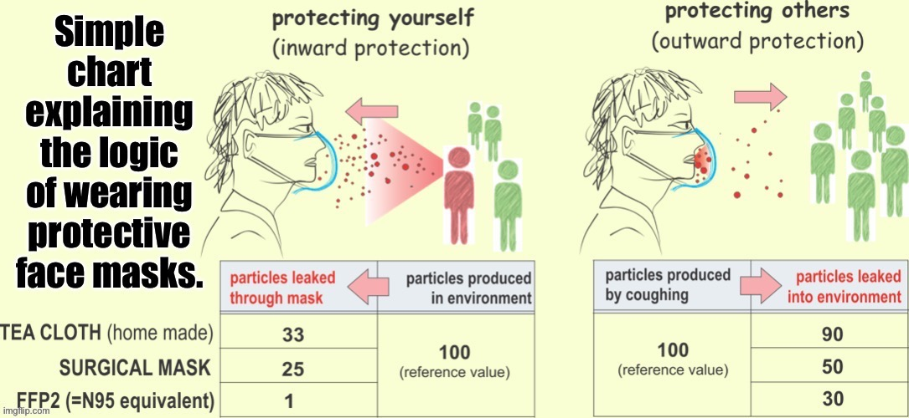
MASK PROTECTION?

Slide 29
Dr. Fauci Rides Again!
Dr. Fauci has now spread fear with warnings about impending and dangerous mutations of COVID-19!
There are no studies to indicate or suggest that healthy persons should wear masks in public! It is another measure to create fear.
Based on WHO and Dr. Fauci’s warnings, mandatory lockdowns kept being extended. It kept Dr. Fauci on TV front and center.
If the actual data were correctly reported, there was no reason medically for the lockdowns.
A terrible effect of the lockdowns prevented hospitals from providing care to patients with cancer, heart disease, kidney failure, etc.

Slide 30
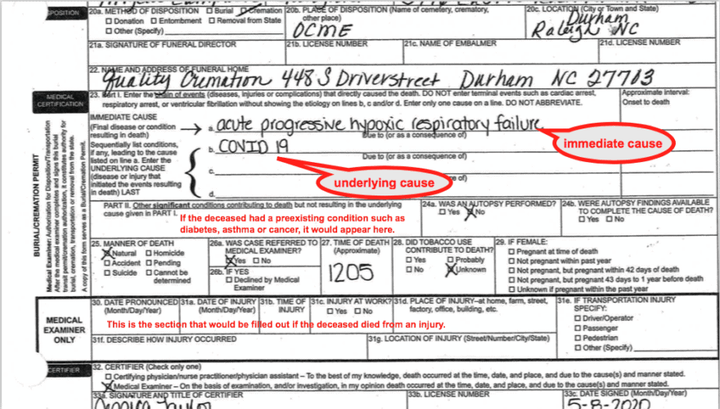
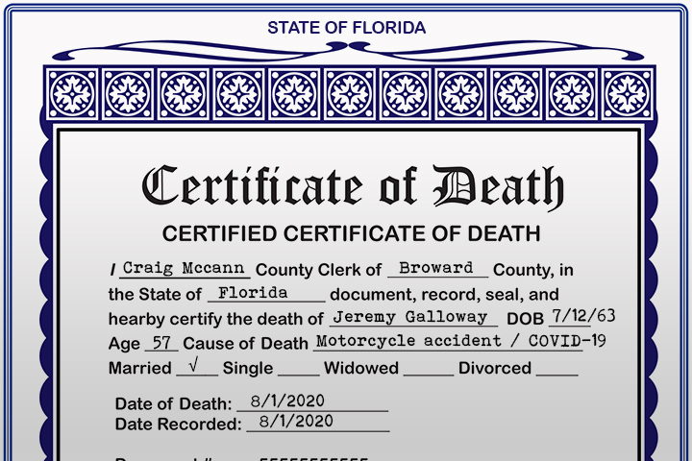
THE SCAM!
In order to continue spreading fear it was necessary to inflate the number of deaths otherwise it would sound too minimal and the Draconian measures would not be accepted. Anyone who died that tested positive for COVID-19 was deemed to have died from it regardless of any co-morbidity. A man killed riding his motorcycle, who tested positive in the morgue, was listed as a COVID-19 death!
The public was scared by a false description of dying from COVID-19 as a “slow drowning” through suffocation.
The public was told that children were dangerous because they could infect older family members.

Slide 31
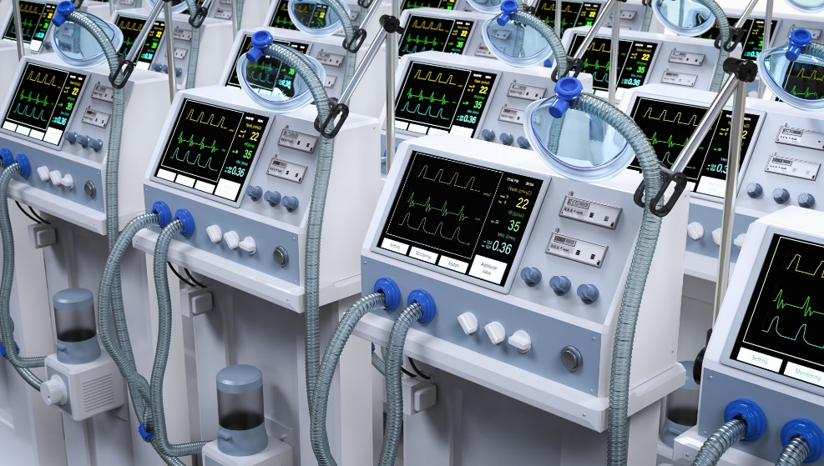
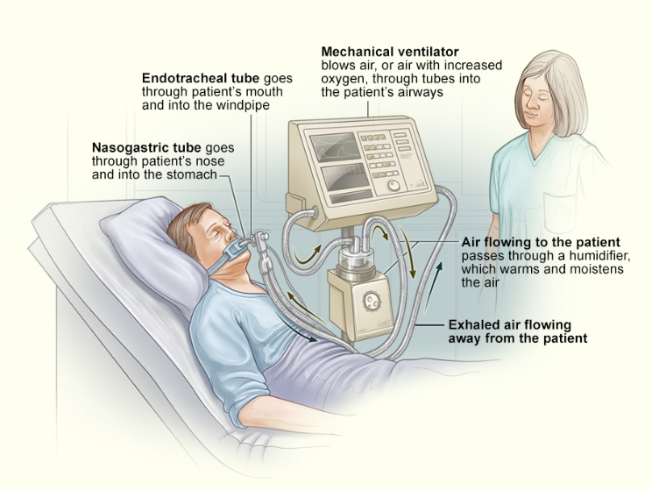
THE SCAM CONTINUED!
Despite continued studies reporting that over 90% of infected persons did not get severely ill, and the virus appeared to have a “99.8%” survival rate among healthy persons, the fear continued.
States like New York estimated they would need over 40,000 ventilators! This never materialized. However, ventilators are also dangerous to respiratory patients due to bacteria in the system causing pneumonia. Putting COVID-19 patients on ventilators early also prevented hospital personnel from infection.
WHAT DID GOVERNMENTS DO RIGHT?

Slide 32
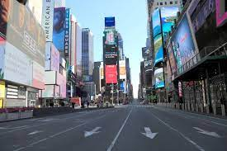
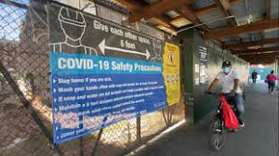
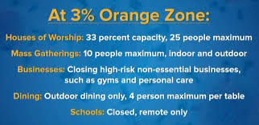
WHAT GOVERNMENTS DID WRONG!
They declared a worldwide pandemic that didn’t exist!
They deprived citizens of their rights!
They made political decisions instead of evidence-based decisions!
They intentionally spread fear to effect population control!
They enforced senseless lockdowns and mask wearing!
They devastated the economy and destroyed countless lives!
They disrupted the healthcare system!
They inflicted great suffering on the populace!

Slide 33
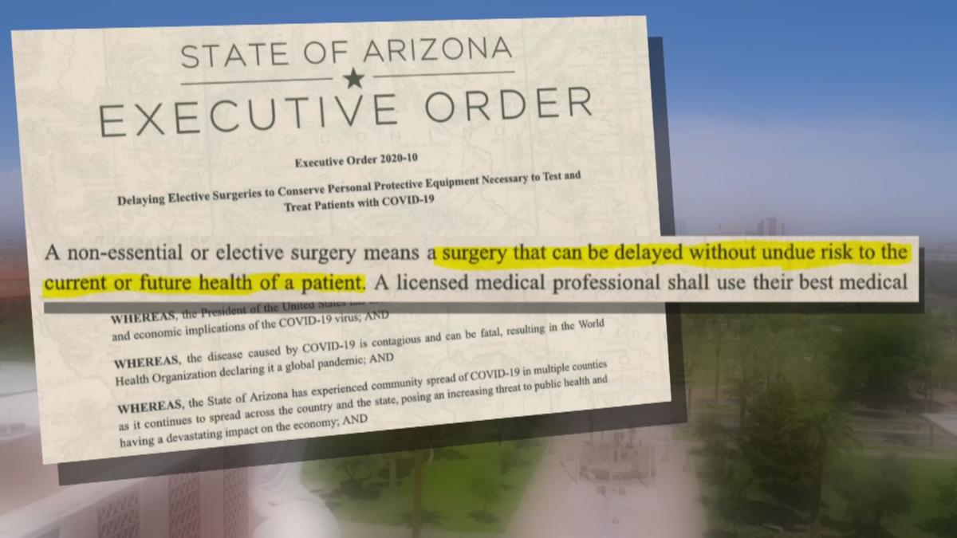
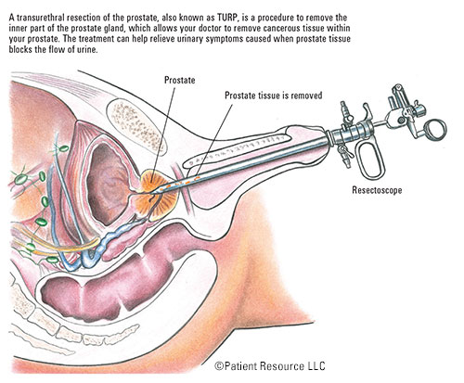
COLLATERAL DAMAGE!
Persons who became ill with other than COVID-19 were afraid to seek medical care!
Elderly, but healthy persons did not want to burden their doctors.
Patients needing medical tests were turned away.
Routine medical check-ups were prevented.
Domestic violence and suicide increased from isolation.
Routine operations were denied such as prostate procedures so not to burden hospitals. (These were declared “non-essential”)

Slide 34
VACCINES ARE THE ANSWER!
To anyone with a hammer, everything always looks like a nail!
In June, 2020, Bill Gates stated, “We will ultimately administer this newly developed vaccine to 7 billion people, so we cannot afford problems with adverse side effects. However, we will make the decision to use the vaccine on a smaller data basis than usual. This will enable rapid progress to be made.”
Was this the correct way to fight a disease with relatively low fatality rates?

Slide 35
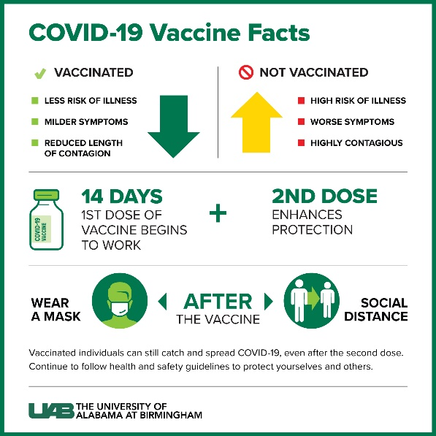
IS IMMUNITY POSSIBLE?
Immunity depends on two pillars: (1) antibodies, (2) specialized cells of our immune system called helper and “killer” lymphocytes.
If test results indicate you have NO antibodies, it doesn’t mean you were not infected!
If test results indicate you DO have antibodies, it doesn’t mean you are immune!
Even if fully vaccinated, it does not guarantee immunity!
Vaccination only means we shouldn’t get seriously ill like any seasonal flu!

Slide 36
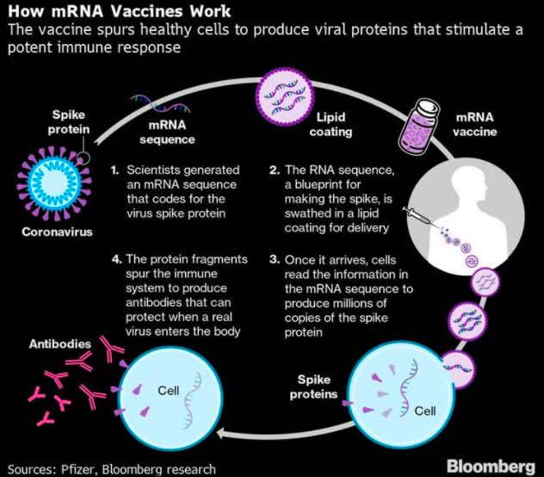

HOW DOES THE COVID VACCINE WORK?
“In molecular biology, messenger RNA is a single-stranded molecule of RNA that corresponds to the genetic sequence of a gene, and is read by a ribosome in the process of synthesizing a protein. Transcription is the process of copying a gene from the DNA into mRNA.” Wikipedia

Slide 37

TO VACCINATE OR NOT?
We should only create a vaccine to prevent serious illness.
Mass vaccination is not reasonable if a majority of a population is sufficiently protected.
Vaccinations will fail when the illness undergoes mutation.
All current COVID-19 vaccines are not safety guaranteed! The makers have all been granted immunity from liability. The vaccines are all experimental!
The current vaccines are gene-based delivered by mRNA to cells, introducing “plasmid” into the cell genome, creating inflammation and toxic effects.
IF you get vaccinated, after several weeks you WILL TEST POSITIVE!

Slide 38
TO VACCINATE OR NOT?
No gene-based vaccine has ever been approved for human use!
The current COVID-19 vaccines have not undergone normally required testing, which is why they needed “emergency use authorization”.
A pandemic must satisfy three criteria: (1) The pathogen must be new. (2) The pathogen must spread rapidly and cross continents. (3) The pathogen must cause serious and often fatal disease.
For example, the Swine Flu (H1N1) under Ford in 1976 and Obama in 2009 only satisfied the first two criteria. The WHO declared a pandemic anyway! In subsequent years, the WHO revised the criteria for politics and money!
Big Pharma makes no profit unless the pandemic becomes worldwide!
More phony “pandemics” include, but are not limited to Smallpox, Polio, the 1918 “Spanish” Flu, and “Legionnaires Disease”.
In 1955 the Surgeon General, Dr. Leonard Scheele, stated, “The only safe vaccine is a vaccine that is never used.”

Slide 39
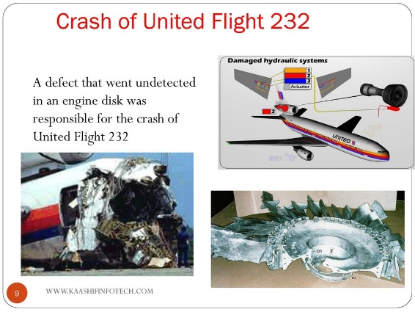
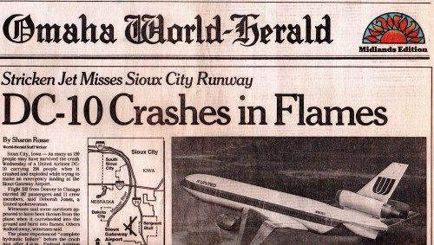
THE “ADR”!
The “ADR” is what actuaries refer to as the “Acceptable Death Rate”! Academics usually call it the “Risk-Benefit Analysis”.
ADRs are factored into nearly every industry including, but not limited to Pharmaceuticals, Aviation, Chemicals, and anywhere there might be a risk associated with any manufacturing process.
For example, Aviation uses the ADR to engineer aircraft with the ADR applied to the manufacturing process taking into account for how much the payout would be to victims of a crash versus the economy manufacturing.
The Covid vaccines are purely experimental, but if you apply an ADR, the death rate from side-effects for the few may overcome the many. The downside is that nobody knows yet what the long-term effects might be.

Slide 40
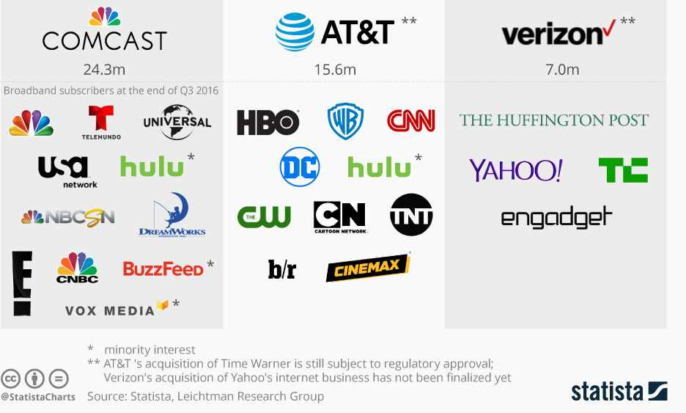
THE MEDIA HELPS THE SCAM!
Mark Twain once stated, “It is easier to fool the public than convince the public they have been fooled!”
In the media, if it bleeds, it leads! Media is based on ratings, and advertisers spend their ad budgets with media with high ratings.
The U.S. major media has become the propaganda arm of both the Democrat Party, and now the current government as well. If they don’t go along, the Democrat Party leaders threaten the media with regulation and control in spite of the First Amendment.
During 2020 open discussions were precluded on most media channels. There was a narrative, and it had to be followed.

Slide 41


MEDIA LIES!
COVID-19 is a numbers game and there are good examples:
The infection rate: the rate continuously increased and it was suggested the healthcare system would collapse. They refused to report the continuing recovery rate.
The mortality rate: we now know that the majority of Americans claimed to have died from COVID-19 didn’t! Stalin once said, it isn’t the amount of votes that count – it’s who counts the votes!
The major media slandered and defamed anyone who argued against the numbers game being reported, and they were censored on sites like Twitter, Facebook, YouTube, and Google.

Slide 42
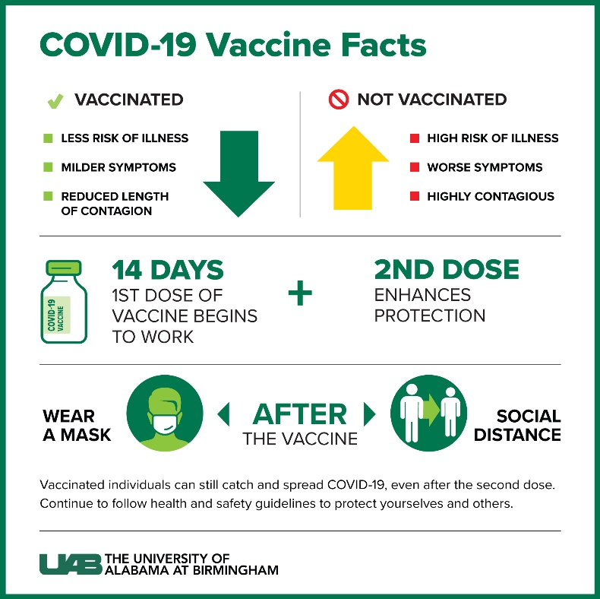
POLITICAL FAILURE?
Either the government and/or their advisers are ignorant or incompetent, OR
This COVID-19 pandemic has been intentionally promulgated, otherwise how do we explain it? Can governments really be that stupid? OR
What could be a possible intention behind the pandemic? Politicians claim that anyone who questions it is a conspiracy theorist.
Is the “science” really being followed?

Slide 43

POLITICAL INTENTIONS
Helmut Schmidt, former Chancellor of Germany from 1974 to 1982 stated, “The stupidity of governments should never be underestimated!” But, have we all been THIS stupid?
Politicians always want to demonstrate their ability to act.
COVID-19 was a blessing for big business. They will survive, Like Amazon, while many small businesses will fail. It winds up being a tremendous redistribution of wealth. The loser is always the taxpayer.
Science is also as corrupt as politics! The field of “science” depends on money, mainly from research grants. If a pandemic is declared, money is just thrown at “science”.

Slide 44

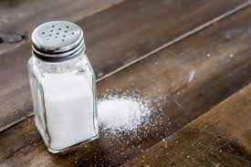
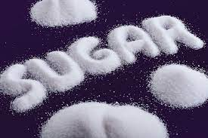
WHAT’S IN THE VACCINES?
Chemicals by which “mRNA is delivered into our cells to provide genetic instructions for our own cells to ““temporarily”” make a “”specific”” viral protein that triggers an immune response.” (CDC)
mRNA = messenger ribonucleic acid. It is not supposed to alter our DNA, but nobody knows the long term effects!
Chemicals in the vaccines are lipids to assist the mRNA enter our cells, salts to balance the acidity in our bodies, and basic table sugar (Sucrose) to help the molecules keep their shape during freezing.

Slide 45
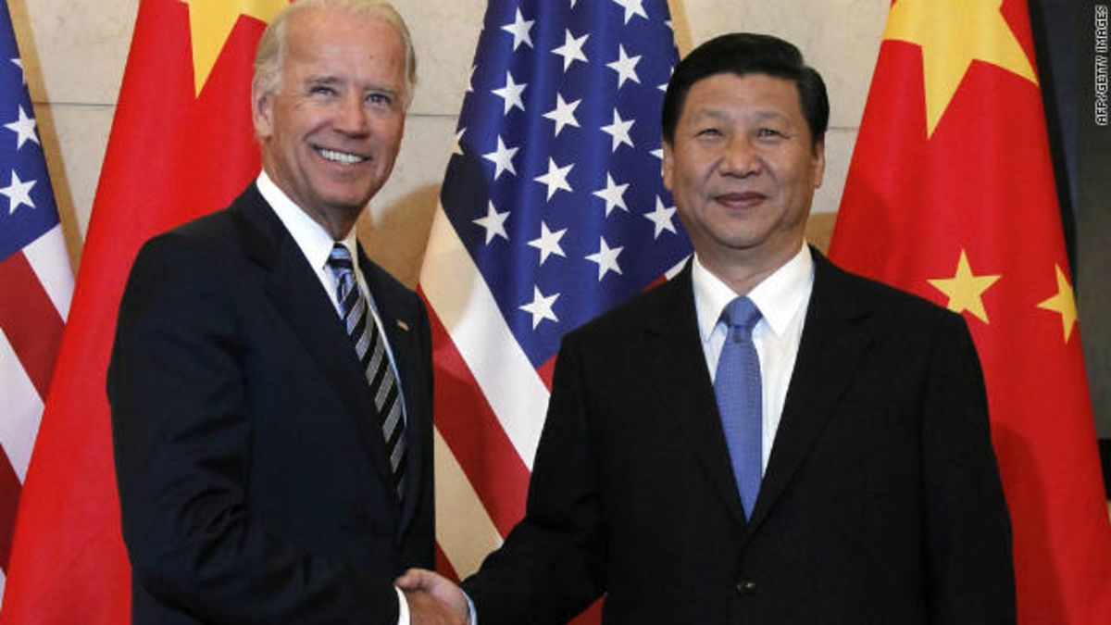
WHAT HAPPENED!
Media mass hysteria!
Arbitrary political decisions!
Massive restriction of personal rights!
Censorship of free expression!
Enforced conformity!
Defamation of different opinions!
Dangerous human experimentation!
SOUNDS LIKE NAZI GERMANY OR CHINA!

Slide 46
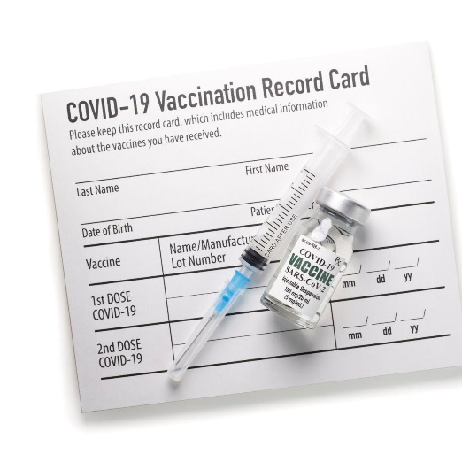
COVID-19 POLITICS!
Vaccination “Passports”! No traveling unless you submit!
No school unless you are vaccinated! No exemptions.
No employment unless you are vaccinated!
No welfare unless you are vaccinated!
No life or health insurance unless you are vaccinated!
Yearly seasonal enforced vaccinations! COVID-19 is here forever!
We now know that politicians and the media can agree to support each other when necessary!
Experiments will continue now that a new route into our DNA has been discovered using gene-based vaccines not knowing the long term effects!

Slide 47
LASTLY…
Respiratory viruses account for some 2-3 million deaths annually worldwide, including the normal seasonal flus.
COVID-19 is now on the list of seasonal viruses.
Respiratory viruses particularly are dangerous to the elderly with pre-existing respiratory conditions. Annually the fatality rate is 0.02% – 0.4%, which is comparable to a seasonal flu.
COVID-19 was never a national concern had it been dealt with proper precautions like other seasonal flus. It was allowed to propagate for political purposes by the media and politicians who sought to benefit from it.
We should never allow this to happen again!

